Slide 1

Introduction to Neural Networks
Dr. Priyanka Shrivastava
Oct 17th,2017

Slide 2
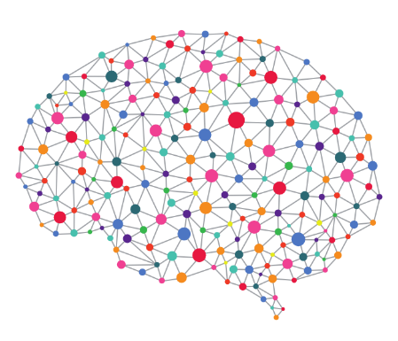
Agenda
Evolution of Neural Networks
Basics of Neural Networks
Fundamentals of Neural Networks
Calculation of Neural Networks
Working example using NeuroXL Predictor
Business Use Case
1
2
3
4
5
6

Slide 3





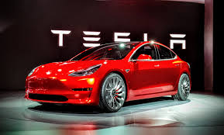



Machine Learning is Everywhere !

Slide 4
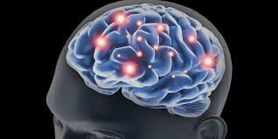

The Art of Neural Networks
Source: Alan Turing, 1948
Turing's Neural Networks of 1948 - AlanTuring.net
“Field of study that gives computers the ability to learn without being explicitly programmed” - Arthur Samuel (1959)

Slide 5
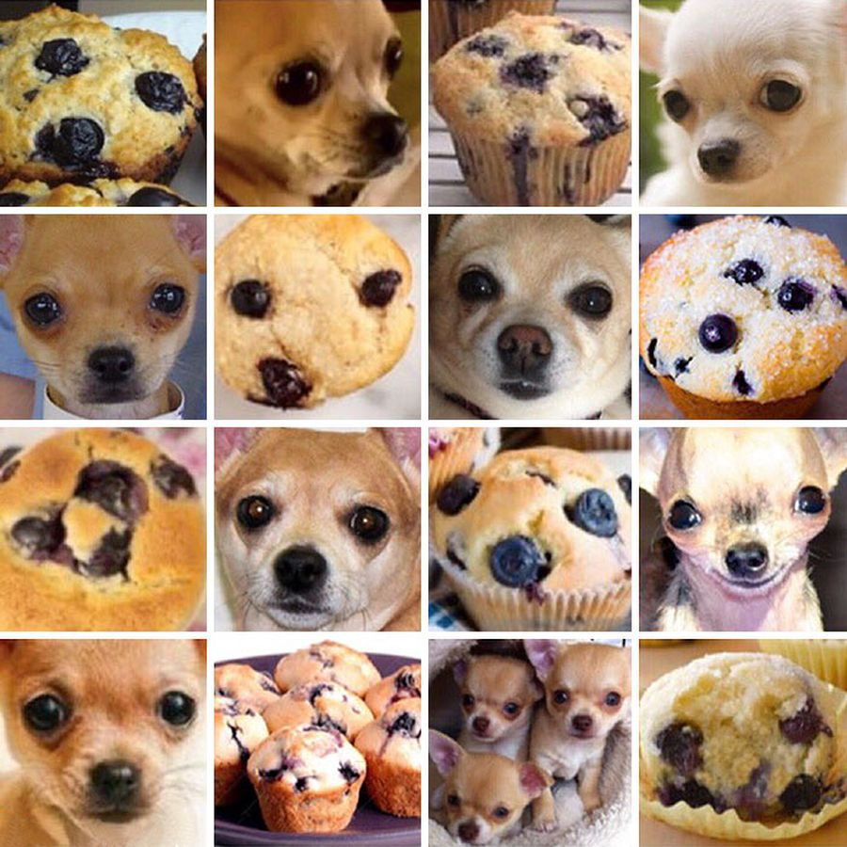
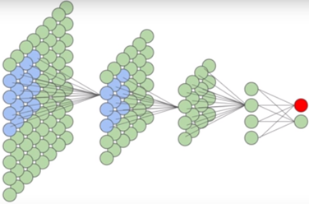
Basics of Neural Networks
“Puppy”
“Muffin”

Slide 6
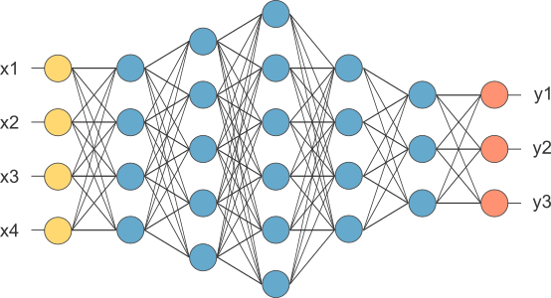
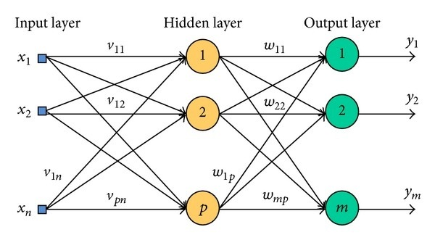
Fundamentals of Neural Networks
Input Layer
Hidden Layers
Output Layer
Three layers of Neural Network
Each layer is made up of neurons
Tasks are performed by hidden layer
Each neuron is connected with neurons in the following layer by weighted links
NN trains itself by changing weights of links
Self connected, short circuiting and recurrent NN

Slide 7
Fundamentals of Neural Networks
Value Ranges from -1 to 1 &
0 to 1
Input 1 | Input 2 |  | Output 1
0 | 0 | = | 0
0 | 1 | = | 1
1 | 0 | = | 1
1 | 1 | = | 0
I 1
I 2
XOR Gate
CSV FILE
0,0,0
0,1,1
1,0,1
1,1,0
O 1

Slide 8
Calculation of Neural Networks
Input Layer
I1
I2
Hidden Layer 1
H1
H3
Output Layer
O1
Hidden Layer 2
H2
B1
B2
H1
H2
B3
Activation Function: Sigmoid, Hyperbolic Tangent and Linear
Bias

Slide 9
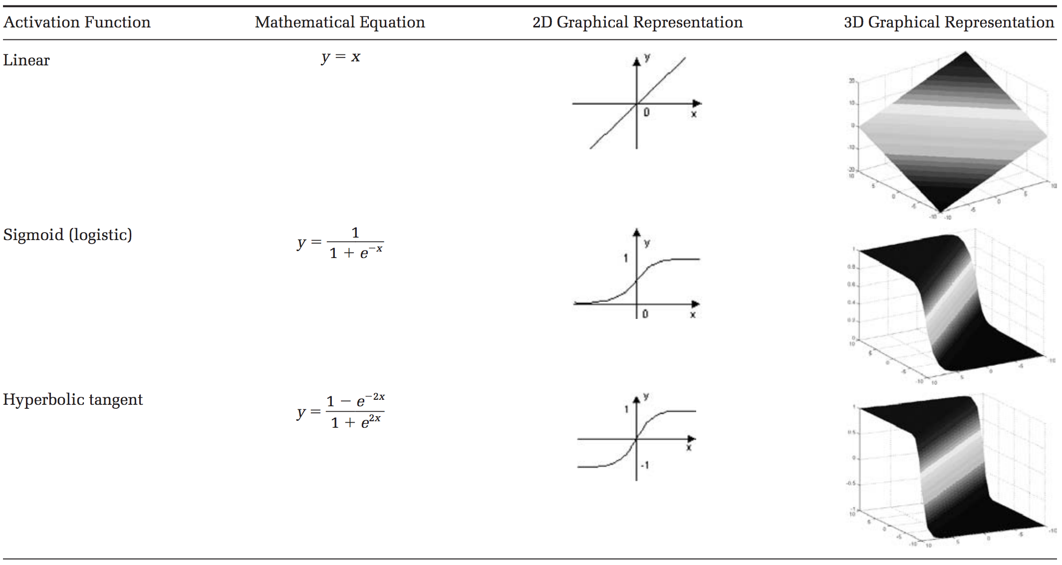
Activation Functions

Slide 10
Applications of Neural Networks: Classification
Example – Classification Use Case & Application
Credit Groups based on Credit Score
Marketing campaigns based on customer loyalty
Consumer demographics and behavior
Targeted Marketing Campaign
Hidden Layer
Good
SMS
Medium
SMS
Mail but no coupon
Poor
No SMS
No Mails
Mail and Coupons
Income
Good
Frequency of Purchase
Medium
Recency of Purchase
Poor
Input Layer
Output Layer

Slide 11
Applications of Neural Networks
Classification Example Contd:
Regression Use Case & Application:
Input
I1 | I2 | I3
Income | Frequency of purchase | Recency of Purchase
$ 50,000 | 12 | 5
1/50k = .0002 | 1/12 = .083 | 1/5 = .2
Miles per gallon
Prediction: Stock prices , Sales based on marketing budget
Regression is basically output of a function f(x). Where x represents all input variables
Working Example
Output
 | Good | Medium | Poor
O1 | 1 | 0 | 0
O2 | 0 | 1 | 0
03 | 0 | 0 | 1
NeuroXL Predictor

Slide 12

Business Case
Maximize Marketing
Campaign
Before
Send mails
to all
After
Send targeted mails
Neural
Networks
Less Response
35 %
More Response
Cost Savings

Slide 13
“Everything should be made as simple as possible but not simpler” Albert Einstein
"Less is more”
Robert Browning
Analysis * Story = Value
THANK YOU!

